Slide 1


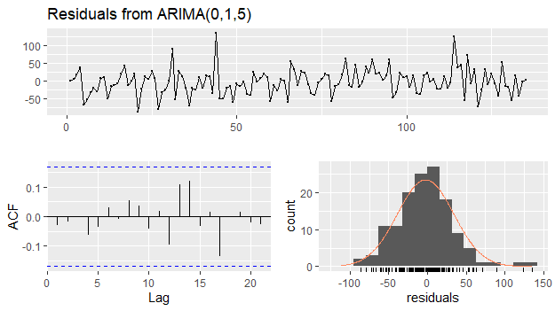
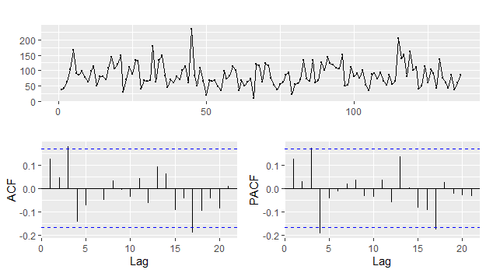
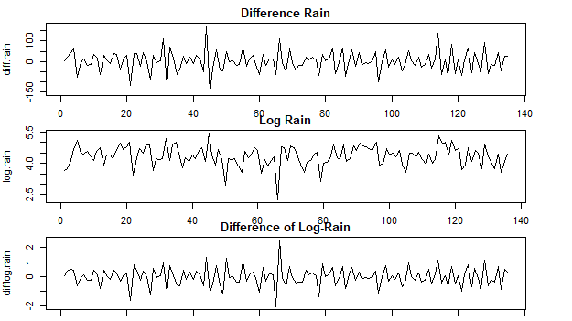
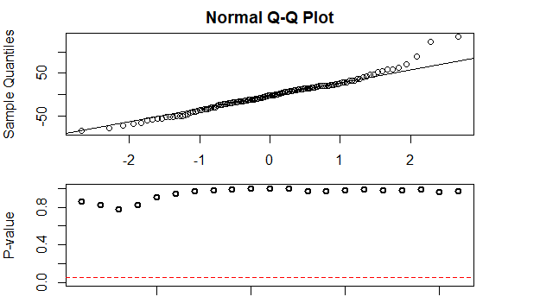
Monthly Precipitation (in mm) London, United Kingdom
Leah Mathew
3rd Year Data Science Student, University of the Sciences, Philadelphia PA
Basic EDA
Model Development
Results
Data is a seasonal time series as seen in the time plot
λ = 0.31
The difference and the log-transformed data were both explored
Used the log-transformed data to move head with fitting the model
These are the AIC values for the overall data
[,1] [,2] [,3] [,4] [,5] [,6]
[1,] 196.0634 145.8657 146.7814 147.2505 142.9406 140.2567
[2,] 177.9141 146.9261 138.9825 140.7710 140.3523 138.8974
[3,] 157.2995 148.8649 140.6826 142.3345 142.2901 139.6733
[4,] 159.2457 146.6612 141.3576 142.2685 143.6789 144.8429
[5,] 154.7928 142.9188 144.9168 144.1450 144.7072 146.5153
[6,] 154.4038 144.9179 142.9918 143.8374 146.4643 148.0160
[1] 138.8974 138.9825 139.6733 140.2567 140.3523 140.6826 140.7710 141.3576
[9] 142.2685 142.2901 142.3345 142.9188 142.9406 142.9918 143.6789 143.8374
[17] 144.1450 144.7072 144.8429 144.9168 144.9179 145.8657 146.4643 146.5153
[25] 146.6612 146.7814 146.9261 147.2505 148.0160 148.8649 154.4038 154.7928
[33] 157.2995 159.2457 177.9141 196.0634
After finding the lowest AIC values, the top five models were assigned to variables and the AIC, BIC, and AICc values for each model were found
ARMA.fit1 <- arima(train, order=c(1,1,5), include.mean=TRUE)
ARMA.fit2 <- arima(train, order=c(1,1,2), include.mean=TRUE)
ARMA.fit3 <- arima(train, order=c(2,1,5), include.mean=TRUE)
ARMA.fit4 <- arima(train, order=c(0,1,5), include.mean=TRUE)
ARMA.fit5 <- arima(train, order=c(1,1,4), include.mean=TRUE)
ARMA.fit <- ARMA.fit5
AIC = -2*ARMA.fit$loglik+2*(length(ARMA.fit$coef)+2)
print(AIC)
BIC = AIC +floor(log(ARMA.fit$nobs)-2)*(length(ARMA.fit$coef)+2)
print(BIC)
AICc = AIC +(2*(length(ARMA.fit$coef)+2)*(length(ARMA.fit$coef)+3))/(ARMA.fit$nobs-length(ARMA.fit$coef)-3)
print(AICc)
Forecasting was used to find the MSE, MAE, and MAPE values
forecast1 <- predict(ARMA.fit1, 36)
forecast2 <- predict(ARMA.fit2, 36)
forecast3 <- predict(ARMA.fit3, 36)
forecast4 <- predict(ARMA.fit4, 36)
forecast5 <- predict(ARMA.fit5, 36)
forecast = forecast5
mse(test,forecast$pred)
mae(test,forecast$pred)
mape(test,forecast$pred)
For the best model the values were as follows:
AIC = 144.2567
BIC = 158.2567
AICc = 145.383
MSE = 0.177
MAE = 0.343
MAPE = 0.0800
Based on the previous values, the model can be determined as ARMA(0,1,5); tests for the model are shown below
Breusch-Pagan = 0.9206
Wilcoxon = 0.2775
Bartels Ratio = 0.5993
Shapiro-Wilk = 0.005485
The data was also modeled to see if there was the need to fit a GARCH model
Data Preparation
Using log-transformed data, the entirety was split between a train and test variable
AIC values were found to determine the five top models that could fit the data
Future Forecasts
#Train/Test Split
train <- log.rain[1:100]
test <- log.rain[101:136]
#Fitting ARIMA Models
aic.fits <- matrix(0,6,6)
for (i in 0:5) for (j in 0:5) {
fits <- arima(train, order=c(i,1,j), include.mean=TRUE)
aic.fits[i+1,j+1] <- fits$aic
}
aic.fits
print(sort(aic.fits))
Point Forecast Lo 80 Hi 80 Lo 95 Hi 95
137 85.66746 37.37746 133.9575 11.81427 159.5206
138 85.66746 37.37746 133.9575 11.81427 159.5206
139 85.66746 37.37746 133.9575 11.81427 159.5206
References
Dr. Abolfazl Saghafi provided the data

